Slide 1
OUR TURTLEBOT
Jacob Steinthal and Sebastian Kittelmann

Slide 2
Contents
Obstacle detection
Movement
Color detection
Collison detection

Slide 3
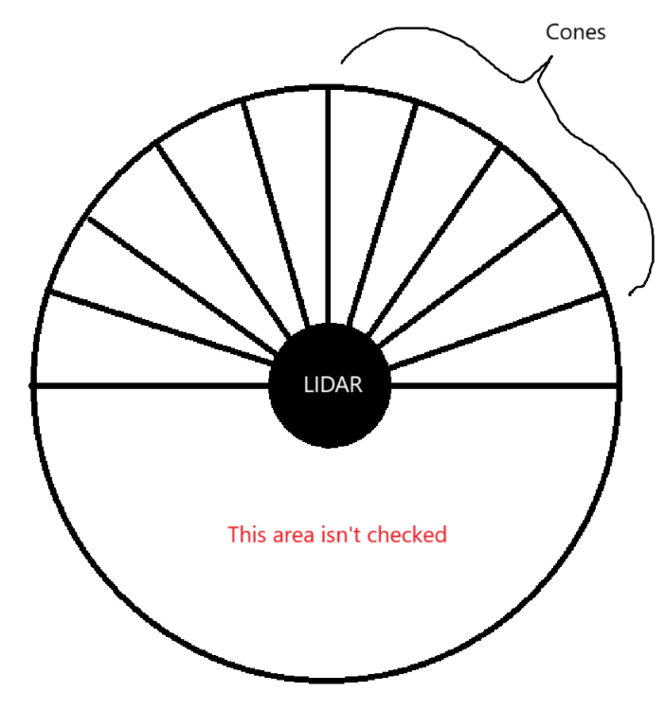
Obstacle detection
Readings from LIDAR
Division into 20 cones
10 frontal cones are the only ones used
Smallest element in each cone is found
Invalid measurements are replaced with 3.5m

Slide 4
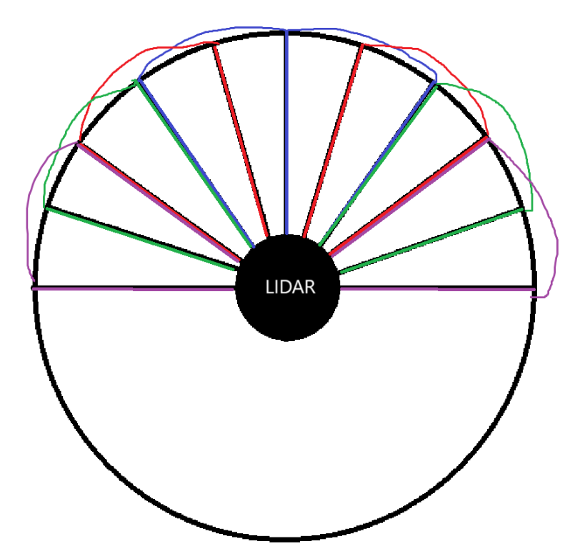
Turning
Goes through cones in pairs
Center cones are prioritized to optimize linear speed
Pair corresponds to size of robot
Firstly looks for big opening – then smaller ones
Then cones 2 and 3
If all else fails: turn right

Slide 5
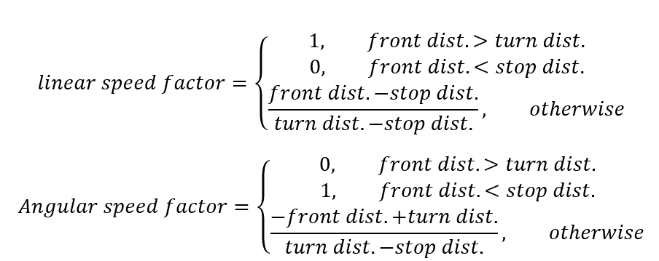
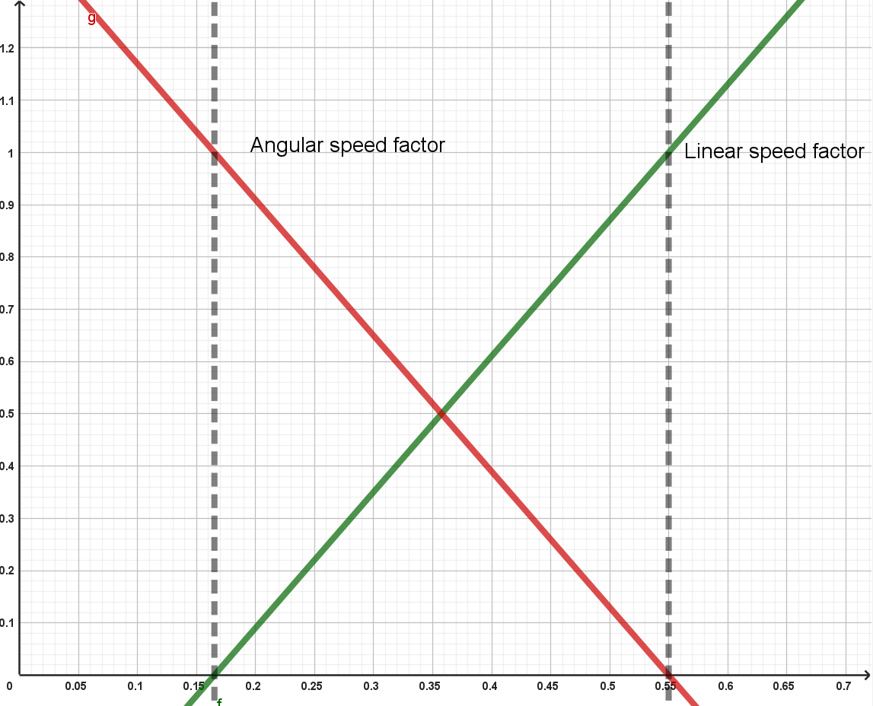
Linear and Angular Speed
Max linear speed: 0.21
Max angular speed: 1.28
Multiplied by factor dynamically set as linear functions of front distance

Slide 6
Color Detection
Normalizing color readings
Multiply with factor to make readings even
Thresholds for red and max values for green and blue
Must detect victim at least twice in the span of 8 readings
Cannot detect new victim in same span
Robot slows down to detect colors better

Slide 7
Collison detection
Issues with just using LIDAR measurements
Used alternative methods
Method #1: Using the length of scan range as an indicator
Method #2: Using amount of NaN measurements as indicator
When colliding: Will start backing up
Also happens when the robot is stuck

